Slide 1
Aerial Images

Slide 2
Learning Objective
I can use aerial images for research
Success Criteria
Understand how aerial images are collected
Use aerial images to identify historical sites
Use aerial images to look at how places develop over time

Slide 3
Introduction
How and why may an area change over time?
How can aerial images help us to understand past events?
What is the difference between a map and an aerial image?
(Scenic Solutions, n.d.)
Notes:
Scenic Solutions, n.d. Landscape change. [Online] Available at: https://scenicsolutions.world/landscape-change/ [Accessed 18 January 2023].

Slide 4
Norderney 14th March 1942

Slide 5
Norderney 20th March 1944

Slide 6
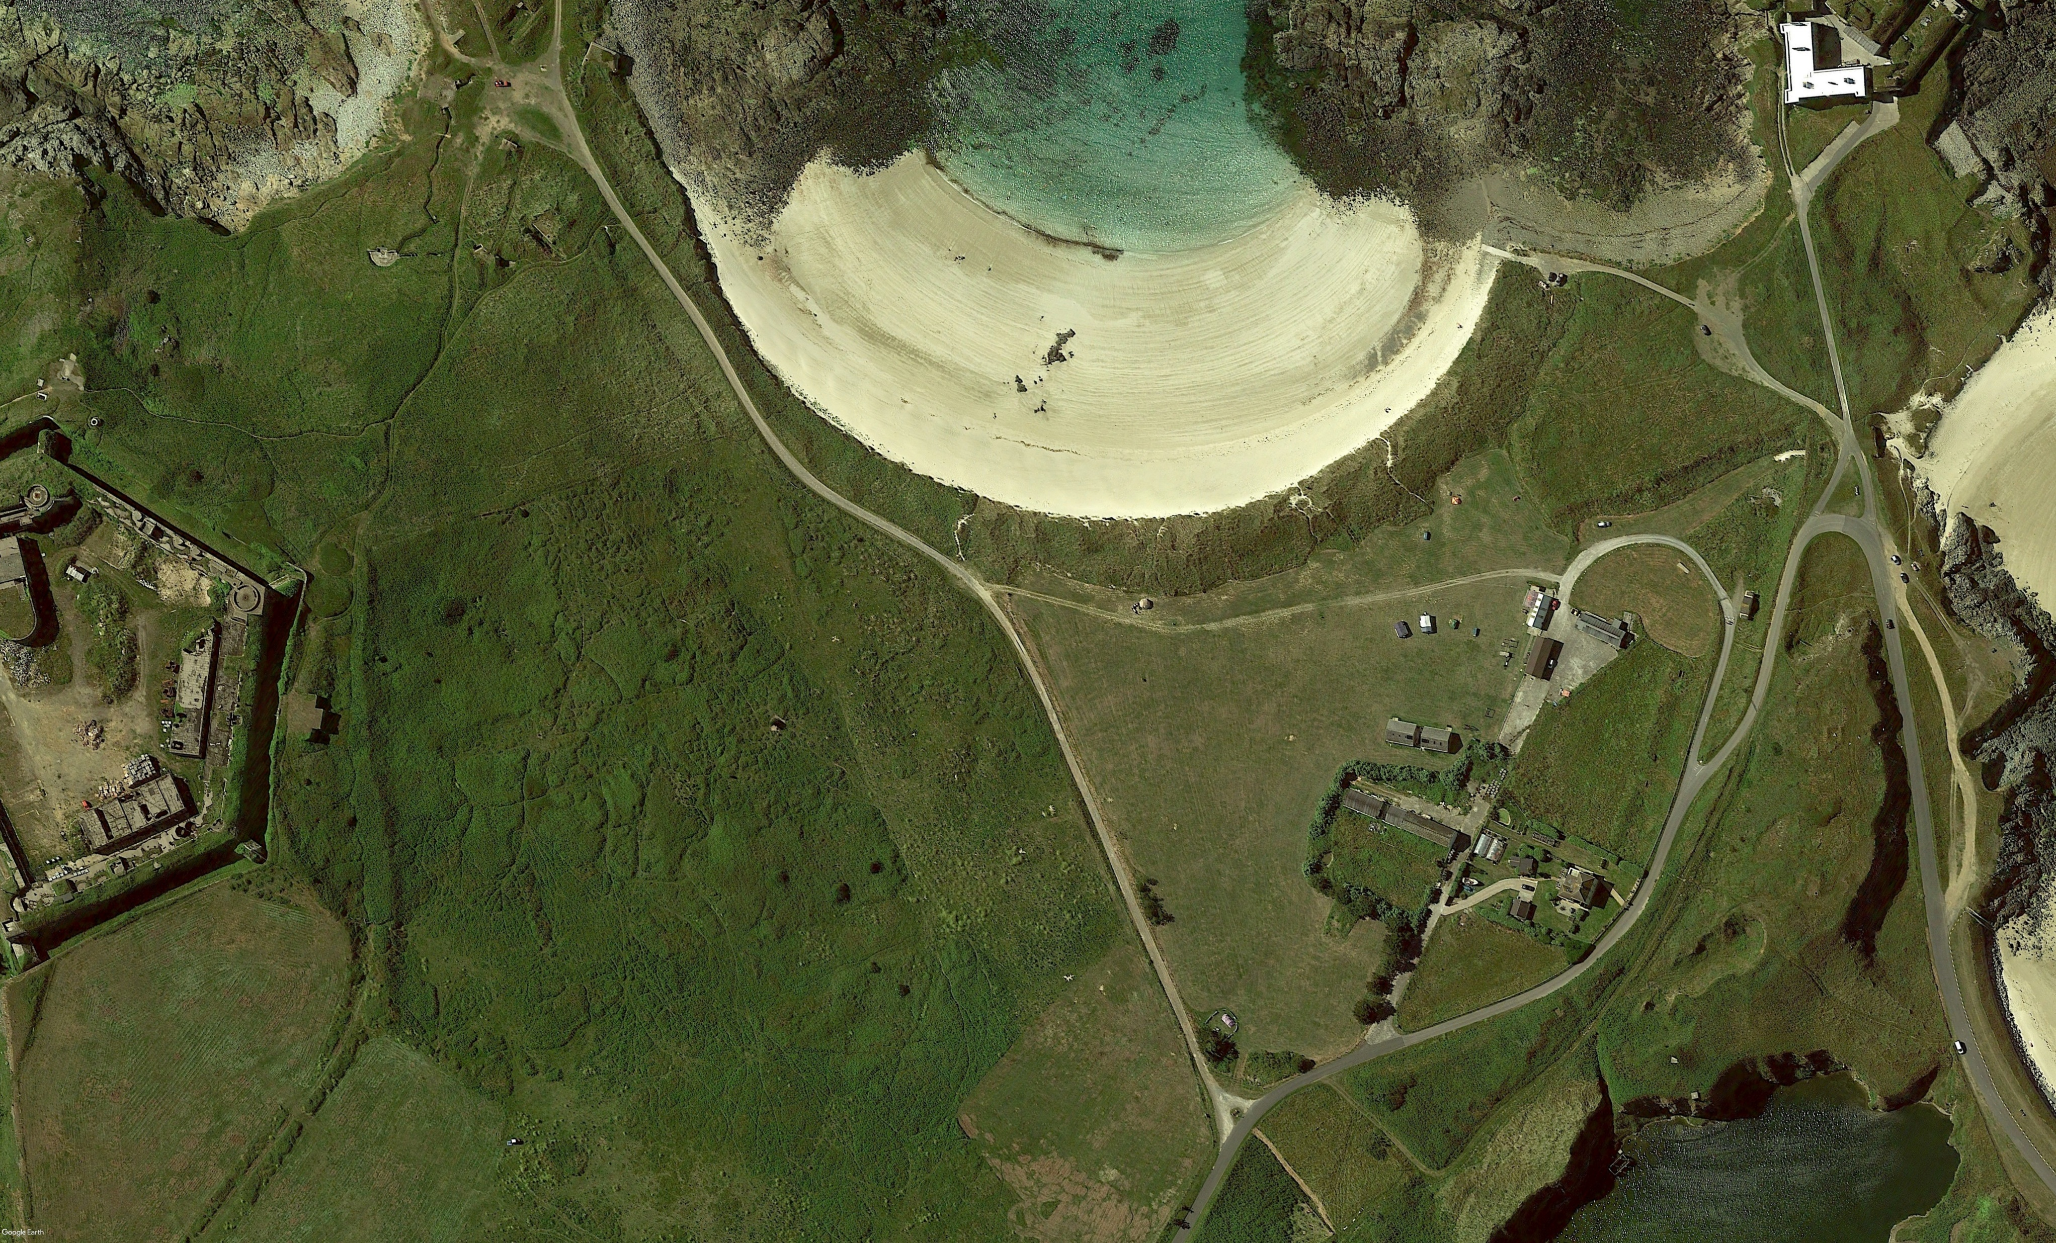
Norderney 2020

Slide 7
Conclusion
What have you learnt about the area by looking at the aerial images?
If you could choose a place to dig on this site where would it be? Why?
Why do you think archaeologists look at aerial images before beginning excavations?

