Slide 1
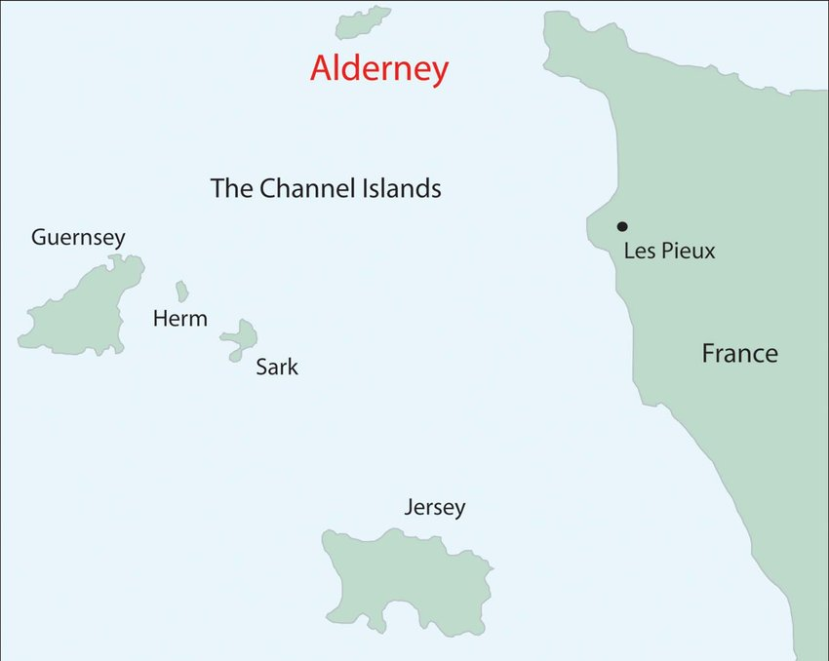
Why Alderney?

Slide 2
Learning Objective
I can identify reasons Alderney was used by the Nazis
Success Criteria
Understand that what happened in Alderney is directly related to the Holocaust and Nazi occupation
Use evidence to determine similarities and differences
Identify reasons why Alderney was used as a camp

Slide 3
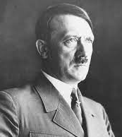
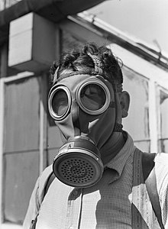
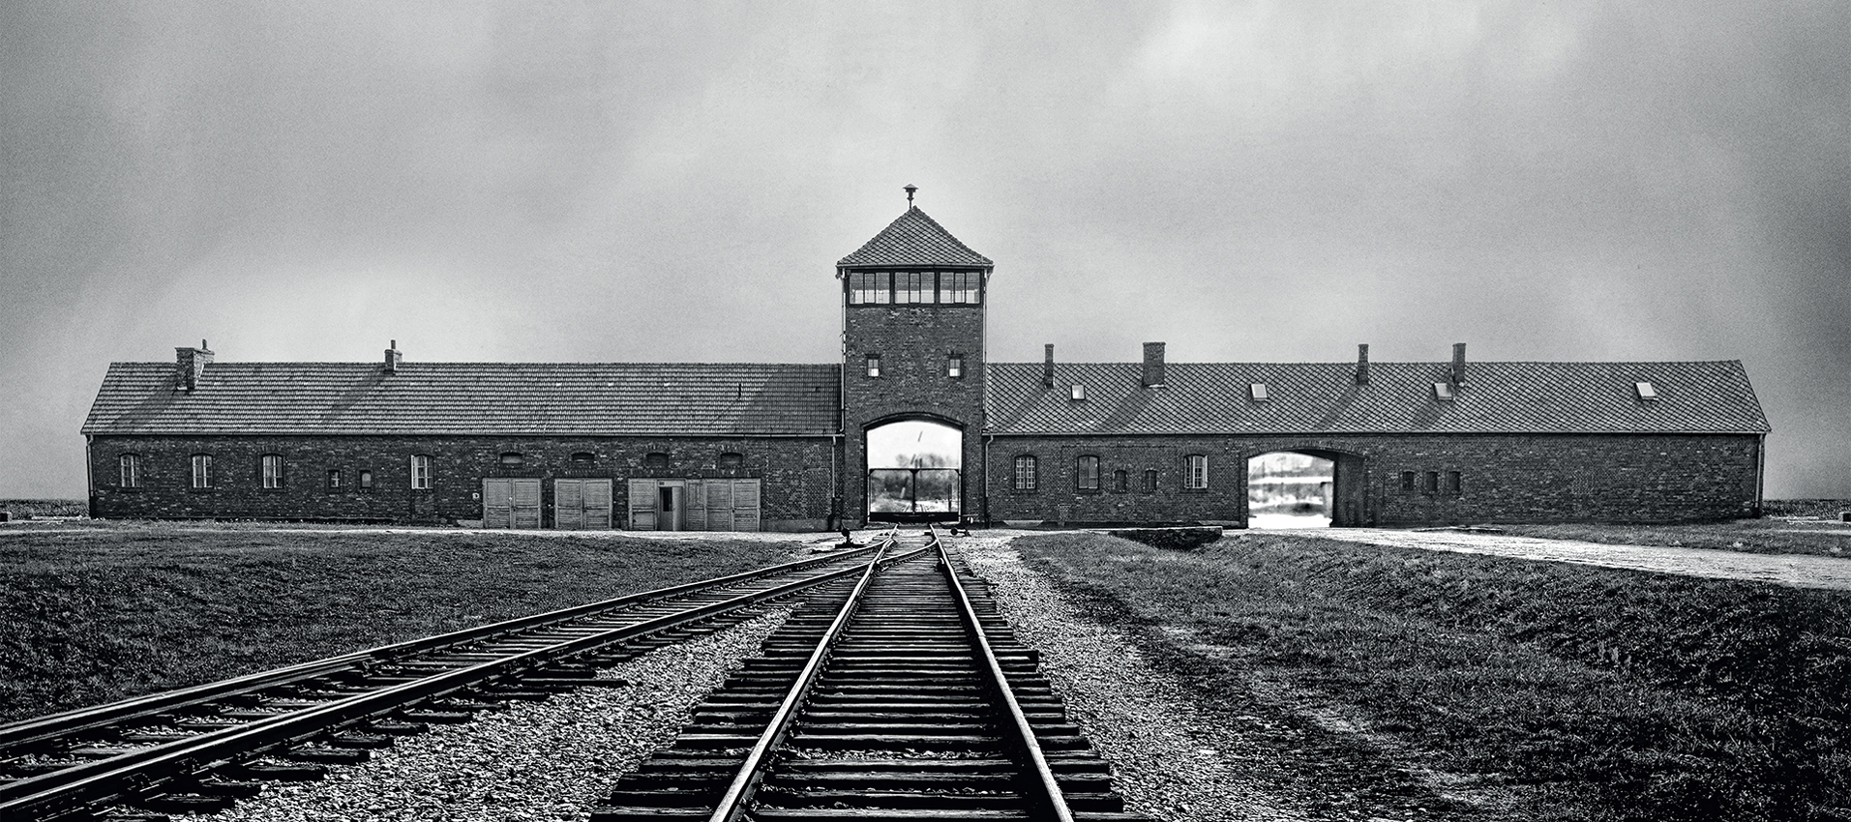
Introduction
What do we already know about the Holocaust?
Are there specific features that make a camp successful? Why?

Slide 4
Look at the worksheet
Can you name similarities and differences between Alderney and other parts of Europe during the Holocaust?
Why did the Nazis use Alderney?
Why do you think the treatment of prisoners was so bad in Alderney?
What made the Nazi concentration camps successful?

Slide 5
Conclusion
What have you learnt about these places and events?
How have archaeologists helped us to gain knowledge about Alderney?
What more could be done and by who?

