Slide 1
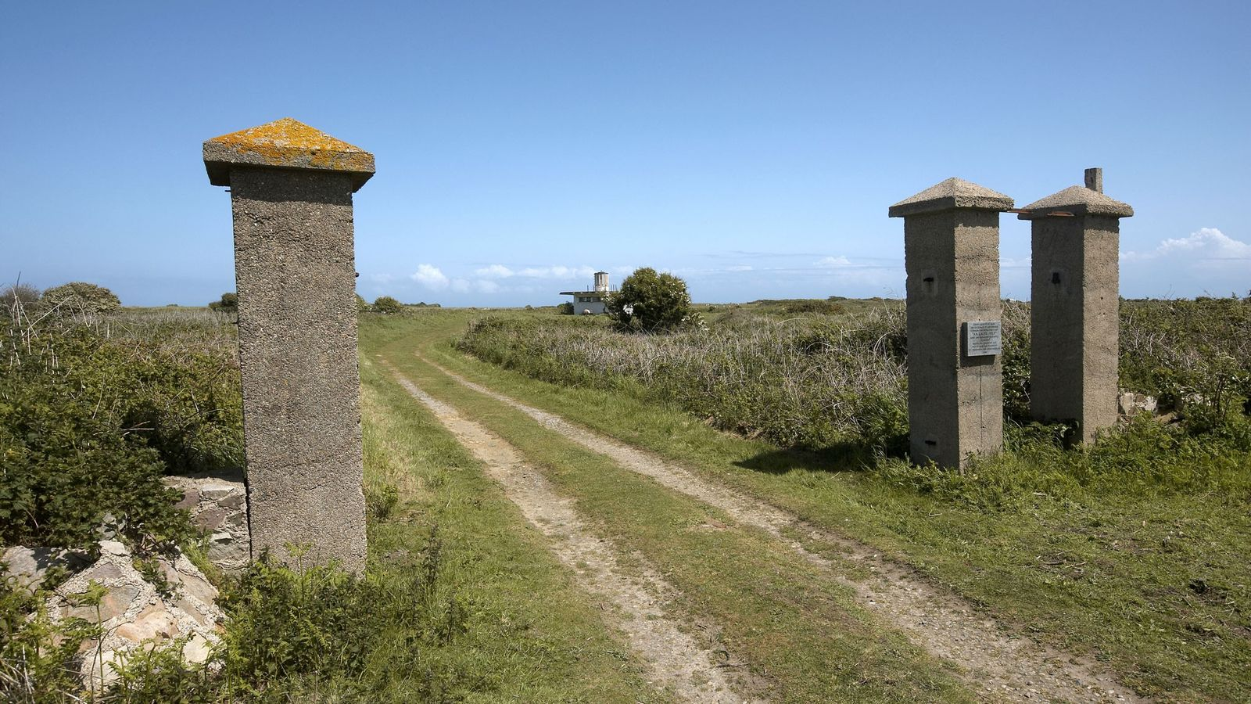
Surviving Evidence

Slide 2
Learning Objective
I can identify the purpose of surviving evidence
Success Criteria
Carefully observe and examine surviving evidence
Give suggestions for how the surviving evidence were once used
Draw and describe the surviving evidence in a scientific way

Slide 3
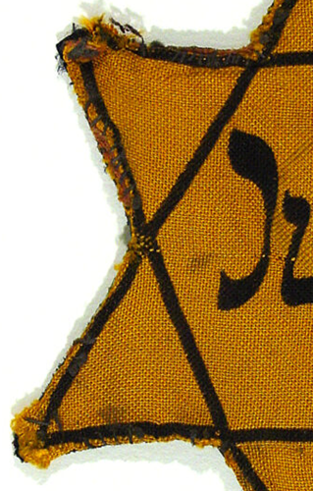
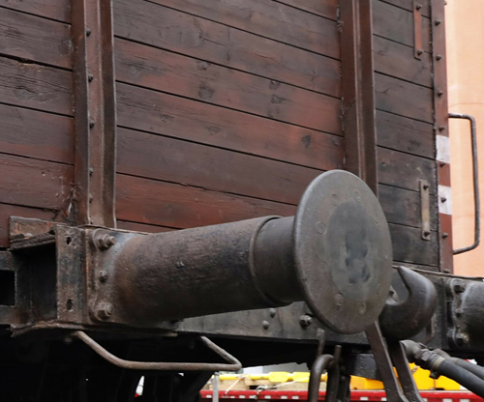
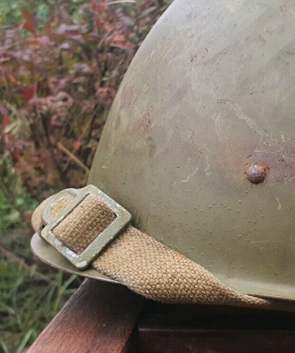
Introduction
What may these items be? Why? What do you think it was used for?
What objects do we use today which people of the future will recognise as belonging to us?

Slide 4
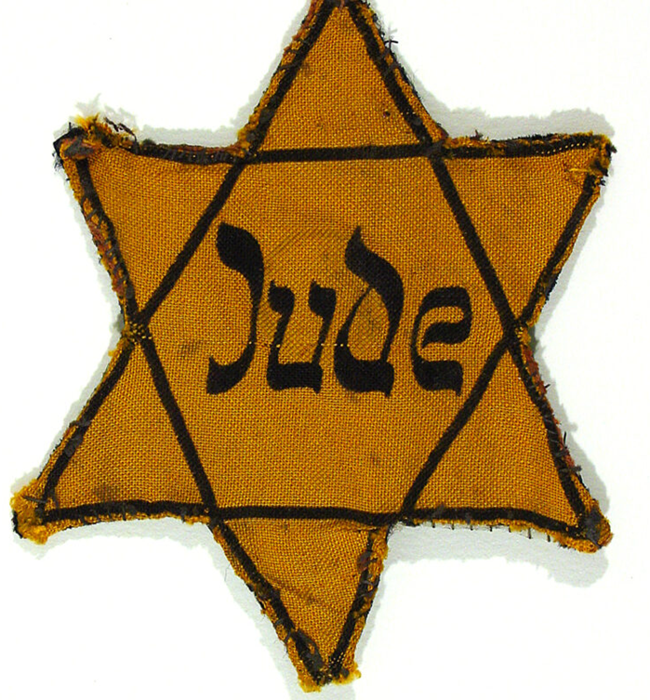
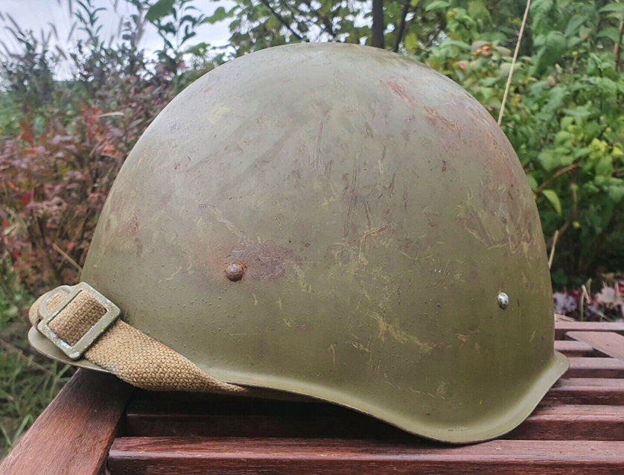
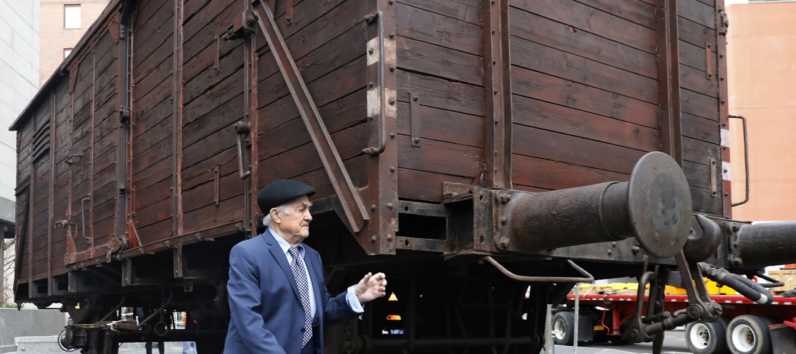
Star of David badge
Helmet
Prisoner Train Carriage

Slide 5
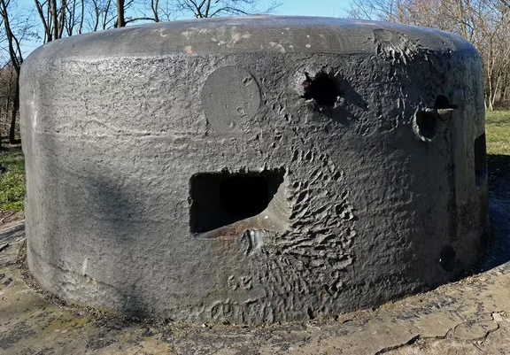
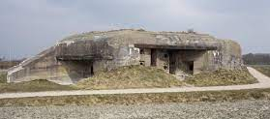
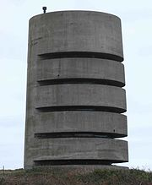
Bunker vs Fortifications
A bunker is a reinforced underground shelter, typically for use in wartime
A fortification is a defensive wall or other reinforcement built to strengthen a place against attack

Slide 6
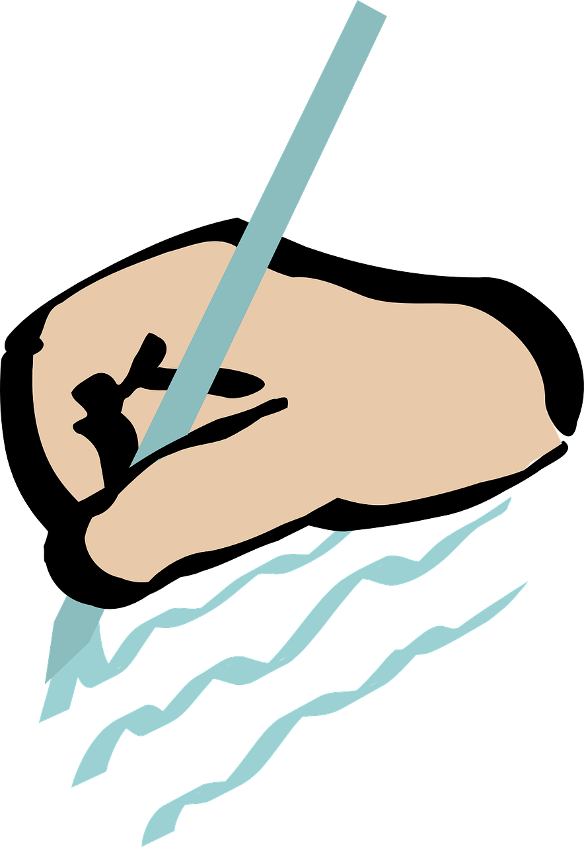
Look at the worksheet
Can you name these surviving pieces of evidence?
What do they tell us about life at the time?
What would they have been used for?

Slide 7
Conclusion
What have you learnt about life on Alderney from the surviving evidence?
Why do you think archaeologists look at surviving evidence? How would it help them?
Why should archaeologists try to recover all pieces of surviving evidence?

