Slide 1
Witness Evidence

Slide 2
Learning Objective
I can use evidence from witness testimony for research
Success Criteria
Understand that not everyone had the same experience during this period
Understand that testimony is a primary resource
Understand the importance of using witness testimony as evidence

Slide 3
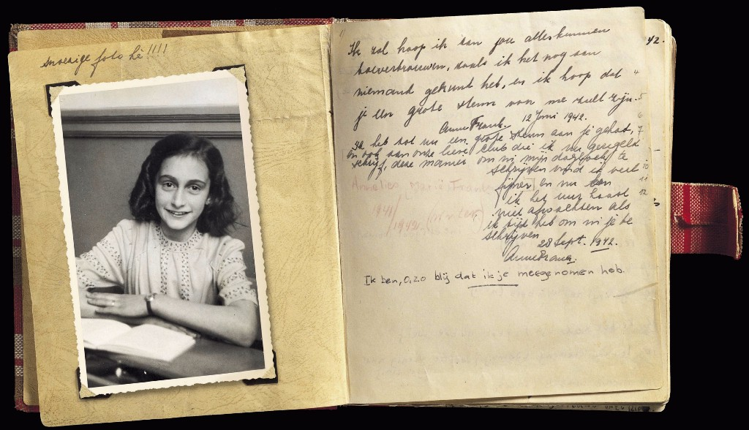
Introduction
What can we learn from witness evidence about the lives of camp prisoners?
What examples of witness testimonies can you think of?
How have they helped us to understand past events?

Slide 4
Profile 1 – Julio Comin
Julio Comin was among the first group of Spaniards to arrive on Alderney on 22 February 1942. He was sent to Alderney as a punishment after he was accused of trying to cut the barbed wire in the camp. He was housed in Norderney where he worked as a barber in the barbershop from May 1942. In his testimony, Comin described several incidents involving ill-treatment by the Camp Commandant Dietz and his subordinates. He stated that Spaniards were paid more than the ‘Russian’ prisoners in Norderney, which allowed them to buy more food than their allocated rations (which matched those of the ‘Russian’ prisoners). Comin remained on Alderney until the July 1944 when he was transported to Jersey. He was liberated when the British arrived there on 8 May 1945.

Slide 5
Profile 2 – Louise Melaine Blamont
Louise Simonet was born on 20 April 1909 in Paris. She arrived on Alderney on 2 September 1942 in the employment of the OT. As a kitchen maid in Borkum camp, she received 3,200 francs a month in wages. After seven months, she transferred to a kitchen operated by the Deubau firm (possibly within a camp on Le Vallée). Between February 1944 and the liberation of Alderney on 16 May 1945, she worked in the Commandant’s house in the kitchen before moving to a house in St Anne where she did laundry and sewing for the Wehrmacht. In her testimony delivered to British investigators on 18 May 1945, she stated that – although she had heard from fellow French citizens that beatings took place on the island – she had not experienced or witnessed any atrocities personally.

Slide 6
Profile 3 – Bendeli Weiss
Bendeli Weiss (born 22 February 1909 in Weissensee [Berlin] Germany) – was one of only three ‘Zigeuner’ (Roma) sent to Alderney as part of SS BB1. However, Weiss had been incarcerated by the Germans long before 1943. Before his departure to Alderney in early March 1943, he was registered in Neuengamme with prisoner number 17,262. He survived incarceration in Sylt concentration camp on Alderney for more than a year. He departed the island with SS BB1 on 24/25 June 1944. Records from Neuengamme, Buchenwald and Mittelbau-Dora camps illustrate his movements from camp to camp between July and October 1944 after his reassignment to SS BB5. In the absence of records it is unclear whether he survived beyond 29 October 1944.

Slide 7
Conclusion
What have you learnt about the events mentioned in the testimonial evidence?
How has this helped with our understanding of the lives of camp prisoners?
Why do you think archaeologists look at testimonies or witness evidence before beginning excavations?

